Slide 1
Capstone Project-4
Netflix Movies and TV Shows Clustering
by- Rutuja Ahire

Slide 2
Problem Statement
This dataset consists of tv shows and movies available on Netflix as of 2019. The dataset is collected from Flixable which is a third-party Netflix search engine.
In 2018, they released an interesting report which shows that the number of TV shows on Netflix has nearly tripled since 2010. The streaming service’s number of movies has decreased by more than 2,000 titles since 2010, while its number of TV shows has nearly tripled. It will be interesting to explore what all other insights can be obtained from the same dataset.
Integrating this dataset with other external datasets such as IMDB ratings, rotten tomatoes can also provide many interesting findings.
In this project, you are required to do
1] Exploratory Data Analysis
2] Understanding what type content is available in different countries
3] Is Netflix has increasingly focusing on TV rather than movies in recent years.
4] Clustering similar content by matching text-based features

Slide 3
Point to Discuss
1] Data Description
2] Exploratory Data Analysis
3] Hypothesis Testing
4] Feature Selection
5] Machine Learning Algorithms(Unsupervised)
a] K-Mean
b] Agglomerative Clustering
6] Model performance
7] Conclusion

Slide 4
Data Description
This dataset consists of listings of all the movies and tv shows on Netflix , along with details such as- cast, directors, ratings, release year, duration, etc.
1.show_id : Unique ID for every Movie / Tv Show
2. type : Identifier - A Movie or TV Show
3. title : Title of the Movie / Tv Show
4. director : Director of the Movie
5. cast : Actors involved in the movie / show
6. country : Country where the movie / show was produced
7. date_added : Date it was added on Netflix
8. release_year : Actual Release year of the movie / show
9. rating : TV Rating of the movie / show
10. duration : Total Duration - in minutes or number of seasons
11. listed_in : Genere
12. description: The Summary description

Slide 5
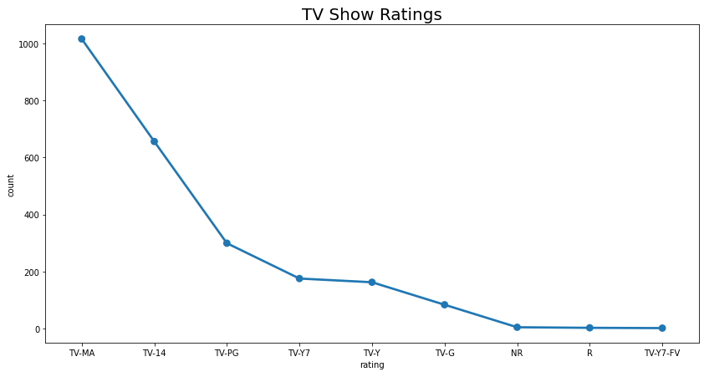
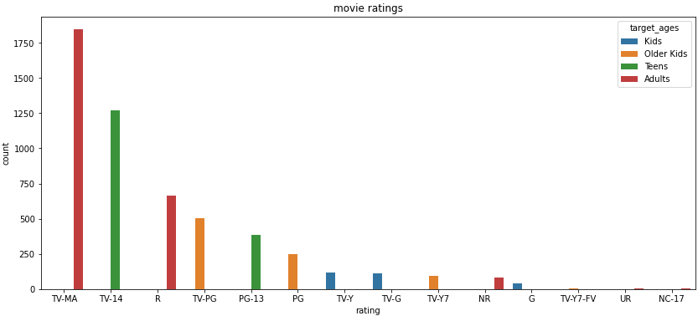
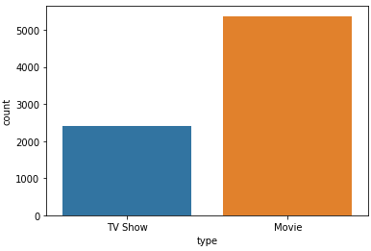
Type Ratings
Netflix has 5372 movies and 2398 TV shows, there are more number of movies on Netflix then the TV shows.
1} TV-MA has the highest number of ratings for tv shows i.e, adult ratings.
2} TV-MA has the highest number of ratings for movies i.e, adult ratings.
3} In both the case, TV-MA has the highest number of ratings.

Slide 6
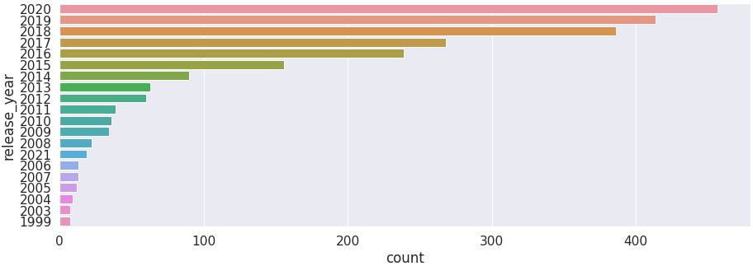
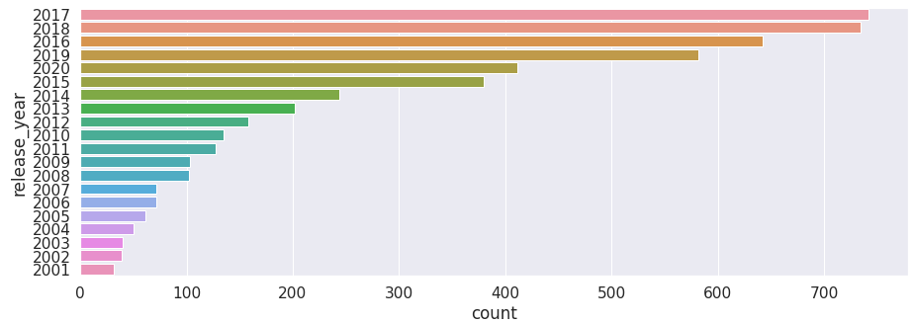
Release year
Movies TV-shows
1] Highest number of movies release in 2017 and 2018.
2] Highest number of movies released in 2020.
3] The number of movies on Netflix is Growing significantly faster than the number
of TV shows.

Slide 7
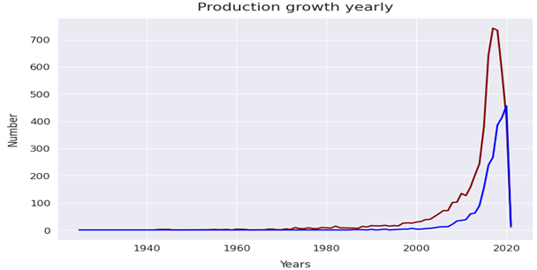
4] we saw a huge increase in number of movies and television of eposides after 2015. 5] There is a significant drop in the number of movies and television eposide produced after 2020. 6] It appeared that the Netflix has focused more attention on increasing movies content than Tv shows. Movies have increased much more dramatically than TV shows.

Slide 8
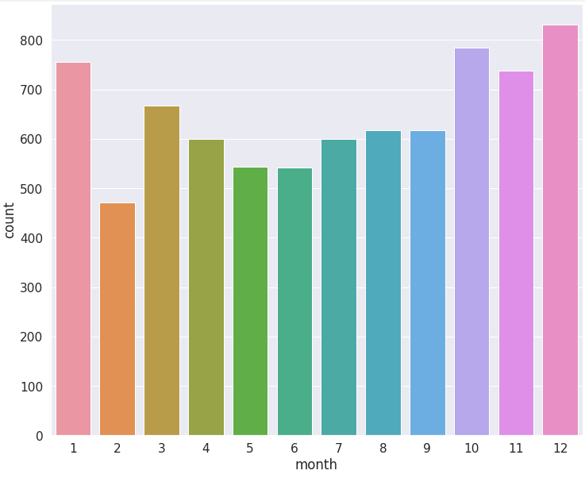
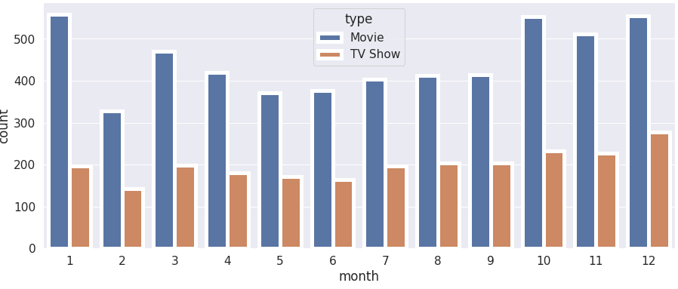
Release Month
The above graph shows that in both the cases the most content is added to Netflix from OCTOBER to JANUARY.

Slide 9
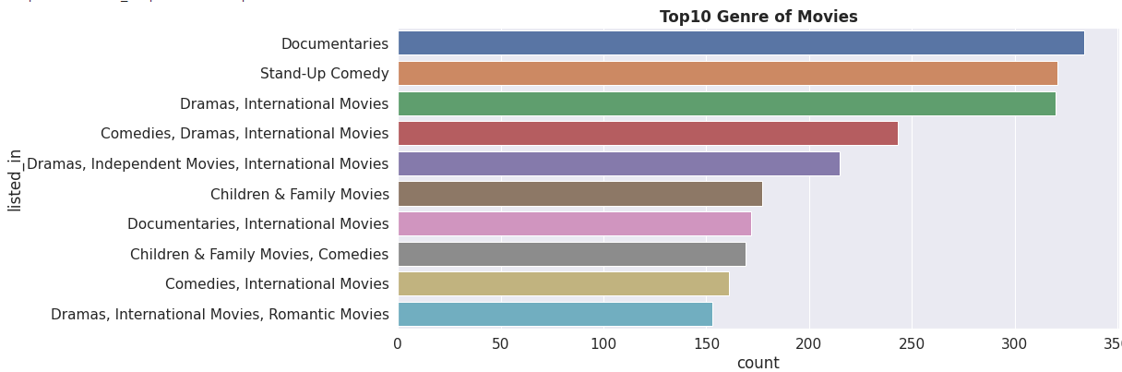
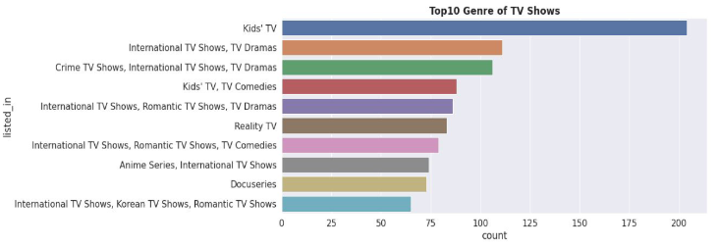
Genre
1. Documentaries are the top most genre in Netflix which is followed by standup comedy, Dramas and international movies.
2. Kids tv is the top most TV show genre in Netflix.

Slide 10
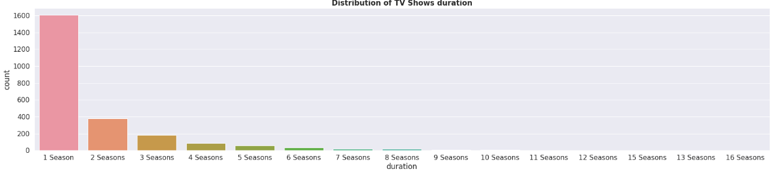
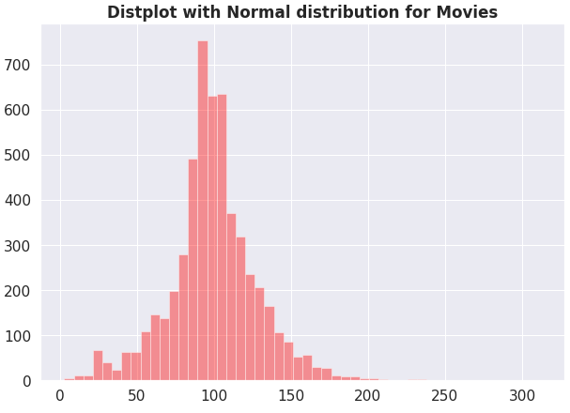
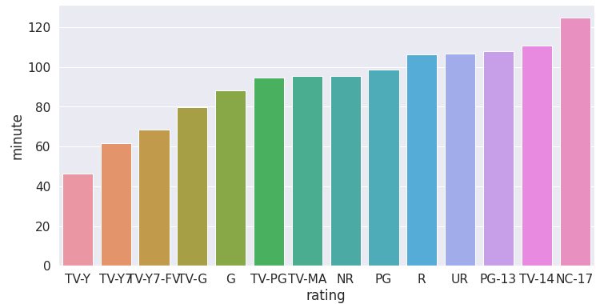
Duration
Most of the movies have duration of
between 50 to 150.
Highest number of tv_shows consisting
of single season.
Those movies that have ratings of NC-17
Have the longest average.

Slide 11
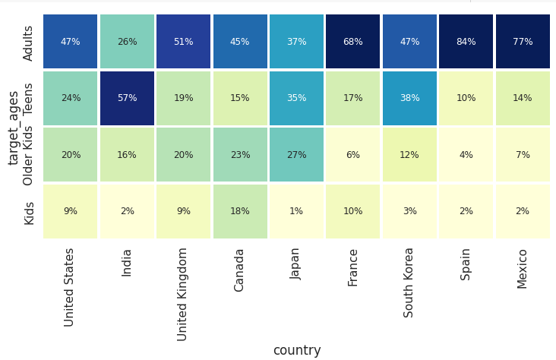
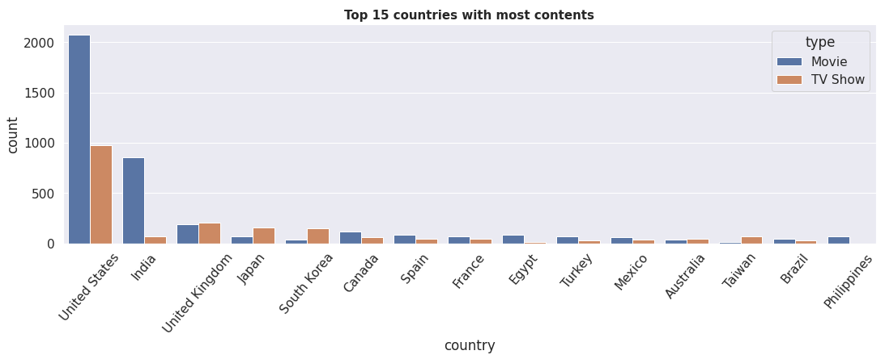
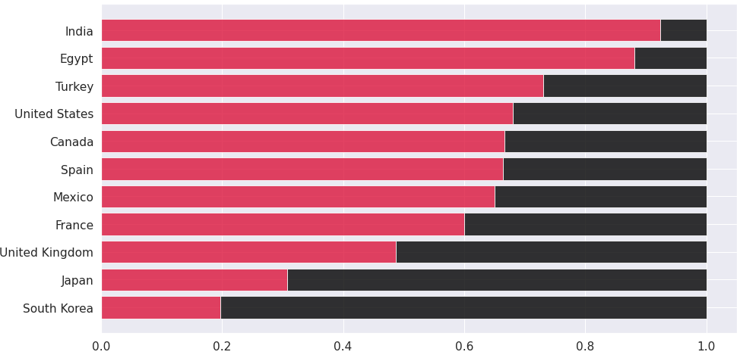
Country
1] united states has the highest number of
content on Netflix, followed by India.
2] India has the highest number movies
3] The US and UK are closely aligned with
their Netflix target ages, but radically from
different from, eg, India or Japan!
4] Also, Mexico and Spain have similar
content on Netflix for different age groups.

Slide 12
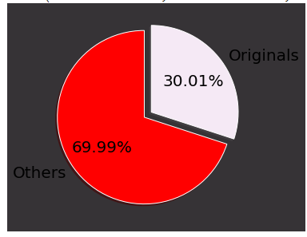
Originals
1} 30% of movies are released on Netflix.
2} 70% of movies were added on Netflix
were released earlier by different mode.

Slide 13
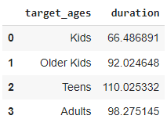
Hypothesis Testing
Hypothesis testing in statistics refers to analyzing assumption about a population parameter.
HO: movies rated for kids and older kids are at least two hours long.
H1: movies rated for kids and older kids are not at least two hours long.
ͦ The t-value is not in the range, null hypothesis is
rejected.
ͦ As a result, movies rated for kids and older kids
Are not at least two hours long.

Slide 14
H1: The duration is more then 90 mins are movies.
HO: The duration is more then 90 mins are NOT movies.
ͦ The t-value is not in the range, the null
hypothesis is rejected.
ͦ As a result, the duration more then 90 mins
are movies.

Slide 15
Feature Selection
ס Initially, separating the column type into movies and tv shows.
סHere we are going to do clustering similar content by matching text-based features so column description is one of the most important feature.
סConvert the text into lower case.
סTokenize the text.
ס Removed all the stops words and punctuation.
סwe use TF-DIF is an abbreviation for Term Frequency Inverse Document Frequency. This is very common algorithms to transform text into a meaningful representation of umbers which is used to fit machine algorithm for prediction.

Slide 16
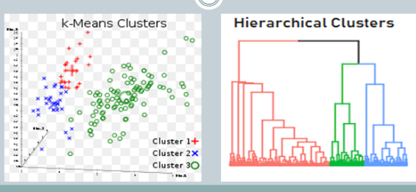
ML-Algorithms (Unsupervised)
1. K-means.
2. Agglomerative clustering.

Slide 17
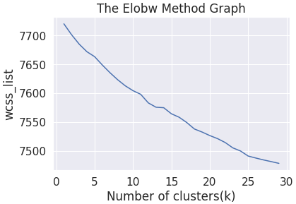
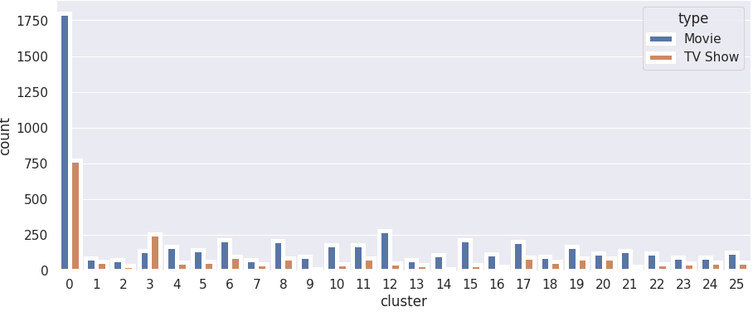
1. K-Means:
סK-Means clustering is an Unsupervised Learning algorithms which groups the unlabeled dataset into different clusters. Here K defines the number of predefined clusters that needed to be created in the process, as if k=2, there will be two clusters, and for k=3, there will be three clusters, and so on.
סfrom elbow method generating 26 ס clusters 0 has the highest number of
clusters. datapoints and evenly distributed for
other cluster.

Slide 18
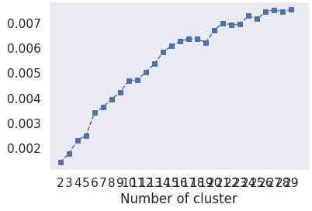
Evaluation:
1.Silhouette score: is a metric to evaluate the performance of clustering algorithms. It uses compactness of individual clusters( intra cluster distance) and separation amongst clusters(inter cluster distance) to measure an overall representative score of how well our clustering algorithms has performed.
2.The Davis-Bouldin index(DBI): It is most commonly used to evaluate the goodness of split by K-Means clustering algorithm for a given number of clusters.
ס Silhouette score would always lie between -1 to
1.1 representing between clustering.
ס Silhouette score is 0.007499010681200968.
ס Davies_Bouldin_Score is 9.05605194948868.
ס so model is performing well.

Slide 19
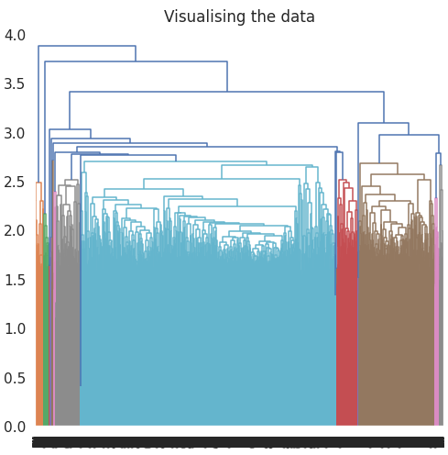
2. Agglomerative Clustering:
1. In agglomerative clustering no need to give the value of k beforehand.
2. The agglomerative hierarchial clustering algorithm is a popular example of HCA.
3. Here I used ward linkage.
4. The optimal number of clusters is 4 using the Dendogram.

Slide 20
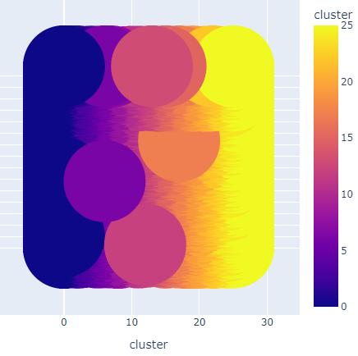
Evaluation:
1] Silhouette Coefficient is 0.002.
2] Davies_Bouldin_Score is 9.05605.
3] comparing with K-mean only Davies_Bouldin_Scoreis better for heirarchial clustering model is not performing well.

Slide 21
Conclusion:
1} From elbow and silhouette score, optimal of 26 clusters formed, K-Means is the best for identification than Hierarchical as the evaluation metrics also indicates the same. In K-Mean, cluster 0 has the highest number of datapoints and evenly distributed for other cluster.
2} Netflix has 5372 movies and 2398 TV shows, there are more movies on Netflix than TV shows.
3} TV-MA has the highest number of ratings for tv shows, i.e., adult ratings.
4} Highest number of movies released in 2017 and 2018 highest number of movies released in 2020. The number of movies on Netflix is growing significantly faster than the number of TV shows. We saw a huge increase in number of movies and television eposides after 2015. There is significant drop in number of movies and television eposides produced after 2020.It appears that Netflix has focused more attention on increasing movie content than TV shows. Movies have increased more dramatically than TV shows.

Slide 22
5} The most content is added to Netflix from October to January.
6} Documentaries are the top most genre in Netflix which is followed by standup comedy, Drama and International movies.
7} kid tv is the top most TV show genre in Netflix.
8} Most of the movies have duration of between 50 to 150.
9} Highest number of TV_shows consisting of single season.
10} These movies that have rating of NC-17 have the longest average duration.
11} when it comes to movies having a TV-Y rating, they have the shortest runtime on average.
12} United states had the highest number of content on Netflix, followed by India.
13} India has the highest number of movies on Netflix
14} 30% movies are released on Netflix while 70% movies are added on Netflix were released earlier by different mode.

Slide 23
Thankyou

